Slide 1

Playful and compassionate approaches for inclusive Information Literacy instruction
Andrew Walsh,
National Teaching Fellow
@Playbrarian (on most social media)
https://playbrarian.uk/
LILAC 2024, Leeds
This Photo by Unknown Author is licensed under CC BY-SA-NC

Slide 2
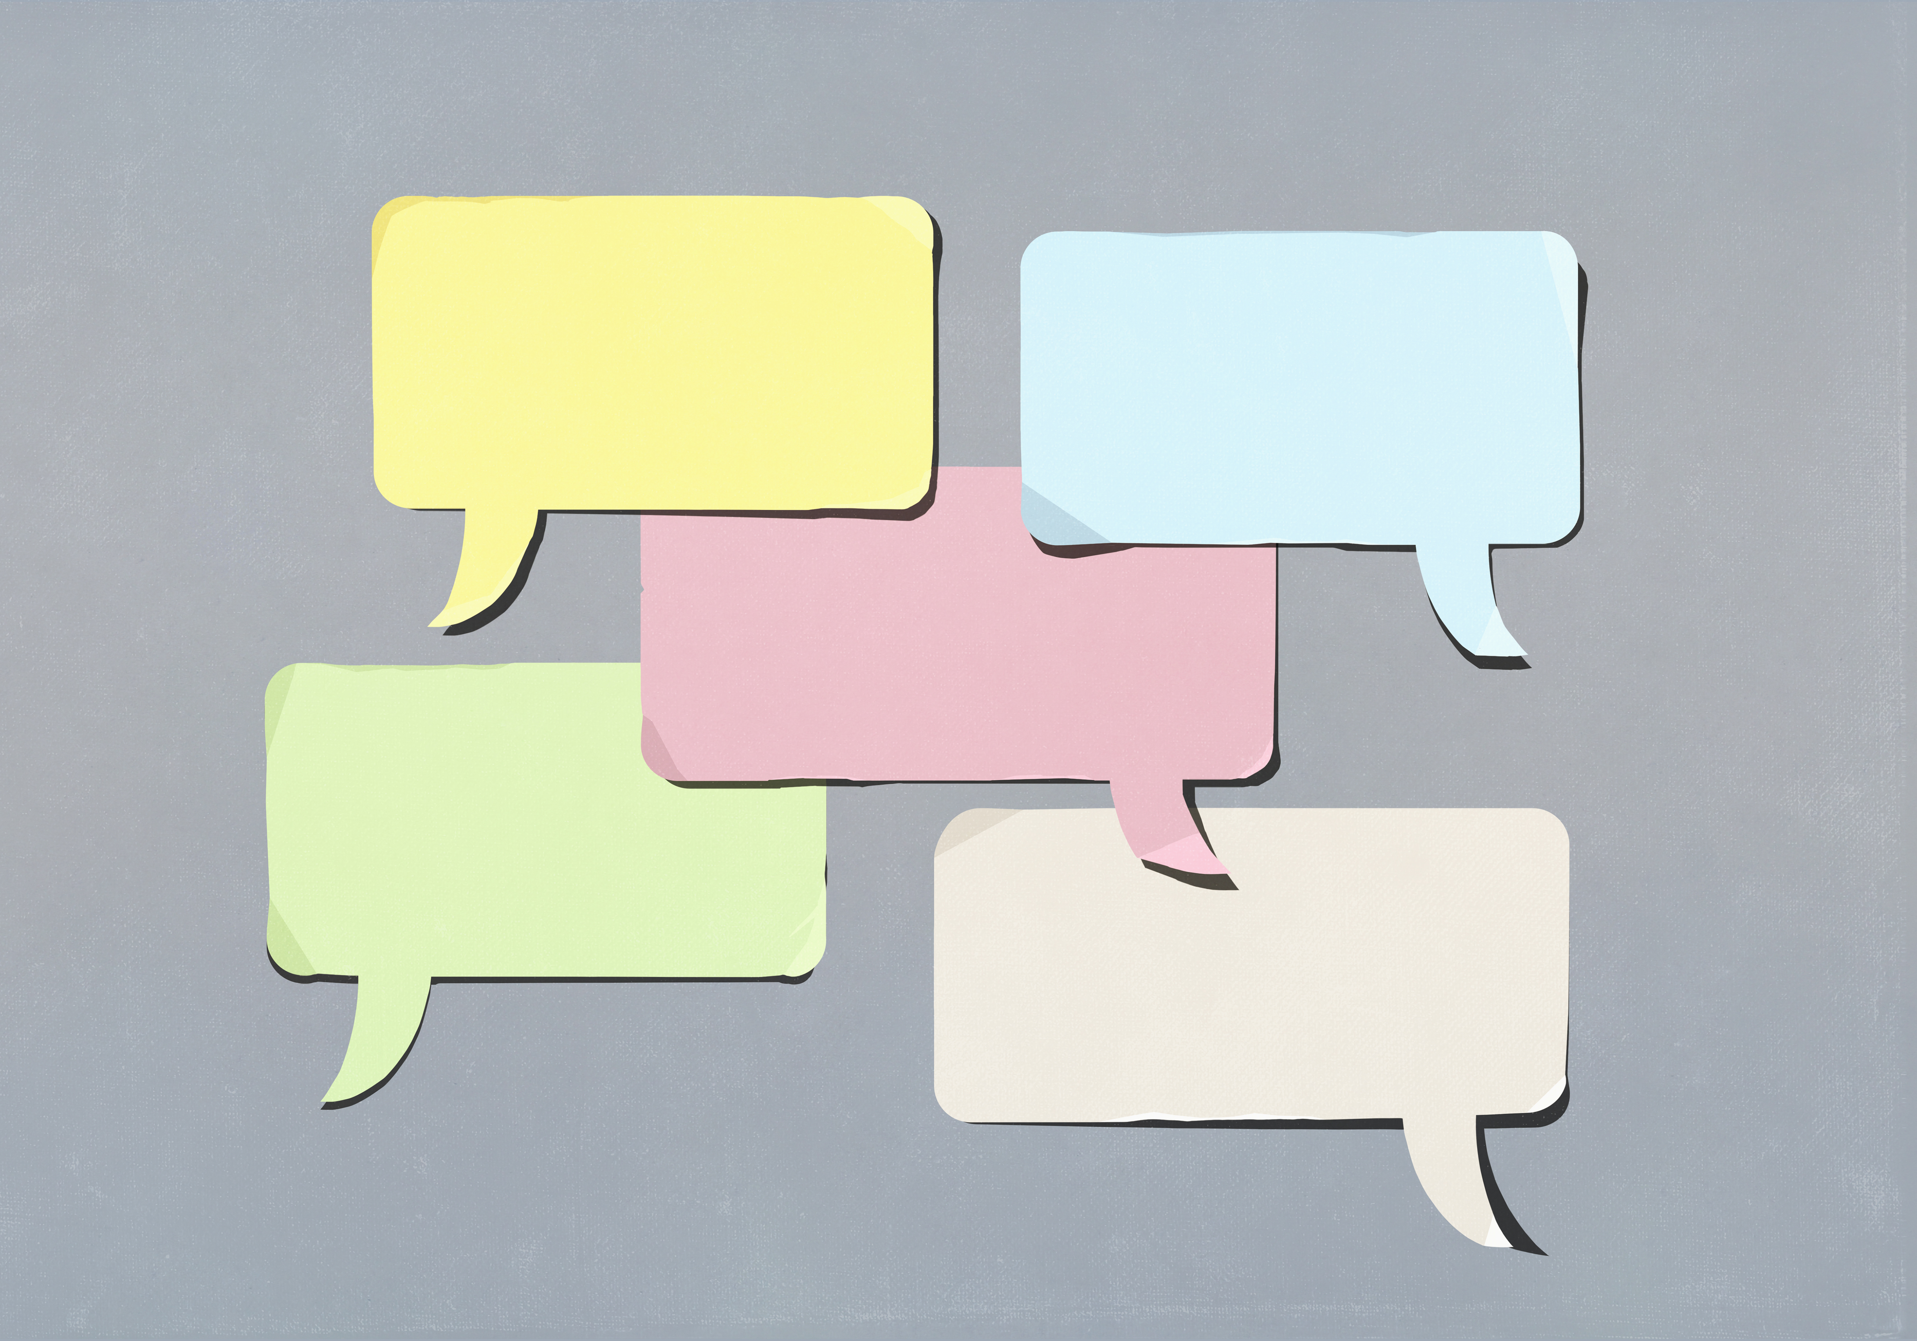
We’ll talk about…
Play, playfulness, playful learning
Compassionate pedagogies
What IL instruction is for
(and we might be a little playful)

Slide 3
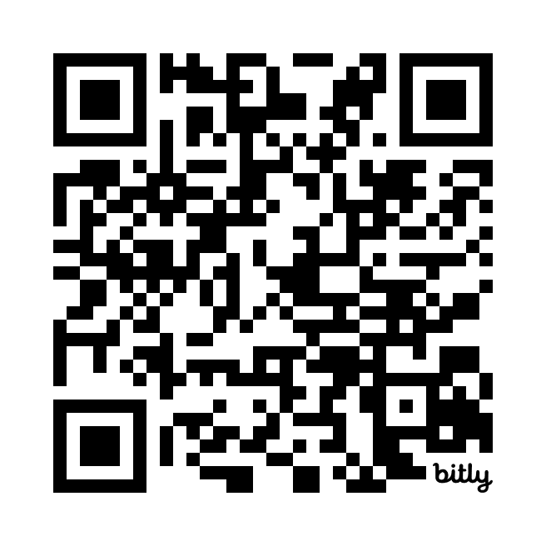
Ask me questions…
QR code or bit.ly/LILAC2024-Andy
Or
In person at the end

Slide 4

Play, Playfulness,
Playful Learning
How I am / could be playful in my teaching!
Write something in the book, pass it on…

Slide 5
I use games, these are…
Structures, a mix of:
A Goal
Rules
A feedback system
(From Jane McGonigal)
"to play a game is to engage in activity directed toward bringing about a specific state of affairs, using only means permitted by specific rules, where the means permitted by the rules are more limited in scope than they would be in the absence of the rules, and where the sole reason for accepting such limitation is to make possible such activity.“
(Bernard Suits)

Slide 6
… but mainly to enable Play
The act, which is:
Apparently Purposeless (done for its own sake)
Voluntary
has Inherent Attraction
Freedom from time
Diminished consciousness of self
Improvisational potential
Continuation desire (Brown & Vaughan)
Bringing all sorts of benefits!
(Mainly when people are genuinely playing.)

Slide 7
Approach centred on Playfulness
The mental attitude
Quite literally, “full of play”, so that is it likely to spill out into play, fun, humour, etc.
So not just games, but other things that encourage play and a playful attitude.
Need to feel psychologically safe to play

Slide 8
Playful approaches to teaching IL?
I’m looking for benefits like:
Shifting power dynamics
Increasing inclusivity
Allowing people to see things from other points of view
Encouraging creativity
And more… which takes us onto…

Slide 9
Ask me questions…
QR code or bit.ly/LILAC2024-Andy
Or
In person at the end

Slide 10
Compassionate Pedagogies
A former colleague used to take this approach, borrowing from “Professional Love” (Jools Page).
But lots of variations:
Recognising / minimising distress
Actively trying to reduce disadvantage
But above all, centring ideas of compassion towards our learners

Slide 11
Compassionate Pedagogies
How I do / could show compassion to my learners?
Write something in the book, pass it on…

Slide 12
Compassionate Pedagogies
“a pedagogical commitment that allows educators to criticize institutional and classroom practices that ideologically place underserved students at disadvantaged positions, while at the same time be self-reflexive of their actions through compassion as a daily commitment” (Hao, 2011)
From the ND angle - “cognitive diversity can be noticed, welcomed and accepted with warmth” (Hamilton & Petty)

Slide 13
Compassionate Pedagogies
Students being listened too & valued
Empowering students to be who they are, celebrating diversity
Create safe environments
Building relationships
More a set of values than directions in how to teach?
https://aldinhe.ac.uk/take5-51-the-best-way-to-develop-a-compassionate-pedagogy/

Slide 14
Compassionate Pedagogies
Can we play without love? Without compassion?
Putting playful learning and compassion together…
Moving power to the learner
The ability to adapt content and structures of sessions to overcome barriers
Hearing all voices involved

Slide 15
Information literacy
“Information literacy is the ability to think critically and make balanced judgements about any information we find and use. It empowers us as citizens to develop informed views and to engage fully with society.”
Relational not absolute.
Nowhere does this say there is one “correct” way of being information literate.

Slide 16
Information literacy
Tension between:
“lecturer wants them to do x”
vs
“their needs are…”

Slide 17
Information literacy
Autistic tendencies & relationships to power?
But I tend towards the “their needs are” end of that spectrum.

Slide 18
Pulling stuff together
I think our IL teaching needs to be learner centred
This fits nicely with shifting power to the learner & compassionate approaches
This fits within playful learning.
Agree? Disagree? How would you place it?

Slide 19
Pulling stuff together
Chance to reflect alongside questions?
https://padlet.com/andywalsh999/LILAC_ANDY
(I can’t draw)

Slide 20
Some references
Brown, S. & Vaughan, C. (2010). Play: How it shapes the brain, opens the imagination, and invigorates the soul. Penguin.
Hamilton, L. & Petty, S. (2023). Compassionate pedagogy for neurodiversity in higher education: A conceptual analysis. Frontiers in Psychology. 14. https://doi.org/10.3389/fpsyg.2023.1093290
Hao, R.N. (2011). Critical compassionate pedagogy and the teacher’s role in first-generation student success. New Directions for Teaching and Learning, 2011(127), pp.91–98.
McGonigal, J. (2012). Reality is broken: Why games make us better and how they can change the world. Vintage.
Suits, B. (1978). The grasshopper: Games life and utopia. Broadview Press.

Slide 21
Thank You and Questions
bit.ly/LILAC2024-Andy
Padlet - https://padlet.com/andywalsh999/LILAC_ANDY
Andrew Walsh, @PlayBrarian
https://playbrarian.uk/
Lots of open training by me coming up:
Teaching Tips for Info Profs, 23rd April
Neurodiversity for Managers, Starting 13th May
Intro to using Lego in Adult Teaching, 15th May
Intro to Playful Leadership, 3rd June

